Slide 1
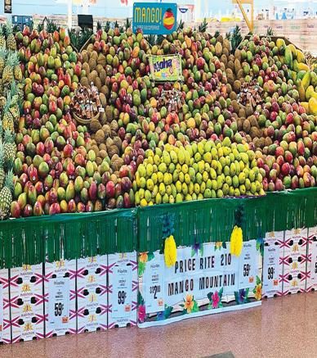
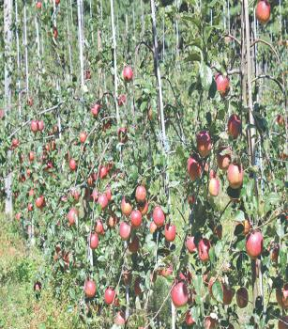
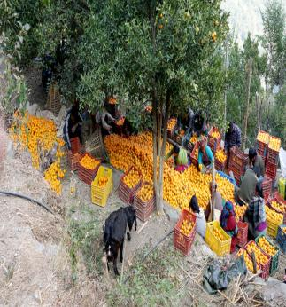
Horticulture in Nepal: Definition, Branches, Importance, and Indigenous Fruits
Presented by: Bikas Basnet
Date: July 6, 2025

Slide 2
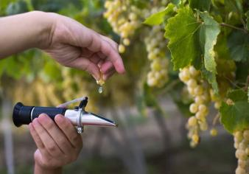
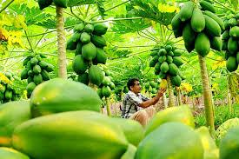


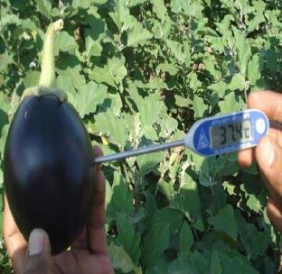

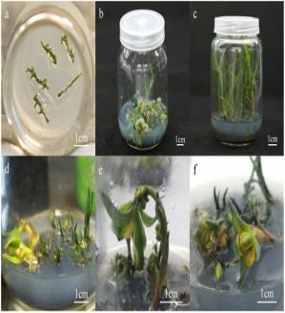

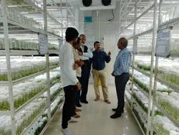
Technologia

Slide 3

Definition and Meaning of Horticulture
Definition: Horticulture, science and art of cultivating garden crops, including fruits, vegetables, ornamental plants, spices, and medicinal herbs, focusing on intensive management for production and enhancement.
Derived from Latin 'hortus' (garden) and 'cultura' (cultivation), it involves meticulous care in planting, growth manipulation, harvesting, and marketing, often in protected environments.

Slide 4
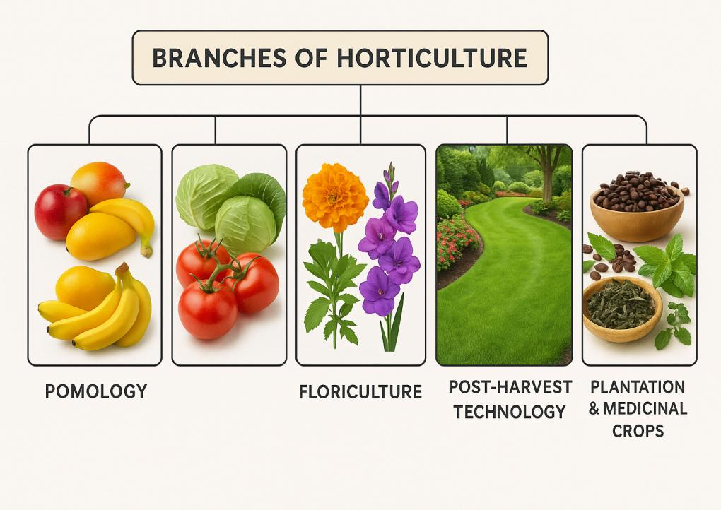
Olericulture

Slide 5
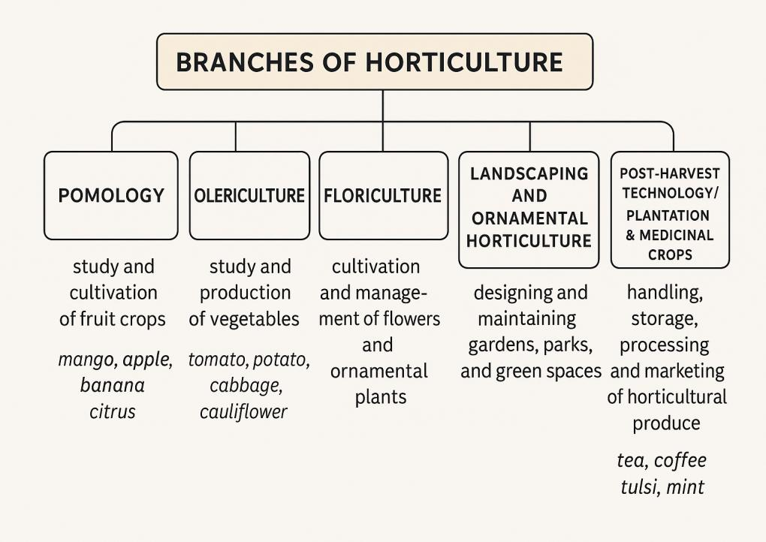

Slide 6
Importance of Horticulture
Nutritional Value: Provides essential vitamins, minerals, and nutrients through fruits and vegetables, combating malnutrition.
Economic Benefits: Higher yields per hectare (e.g., bananas yield 15M calories/acre vs. wheat’s 1M).
Employment Generation: Creates 860 man-days/year for fruit crops vs. 143 for cereals.
Industrial Input: Supports industries like canning, juice production, and essential oils.
Environmental Impact: Enhances aesthetics, reduces erosion, and improves air quality.

Slide 7
Scope of Horticulture in Nepal
Agro-Climatic Diversity: Nepal’s tropical (75-750m), subtropical (750-1500m), and temperate (>2000m) zones support diverse crops.
Export Potential: Mandarin, sweet orange, large cardamom, and off-season vegetables have international demand.
Urbanization: By 2030, 50% of Nepal’s population will be urban, increasing demand for horticultural products.
Employment Opportunities: Production, processing, and marketing create jobs for rural and urban youth.
Import Substitution: Local production of mango, banana, and vegetables can reduce imports (e.g., apples: NRs 1.9B).

Slide 8
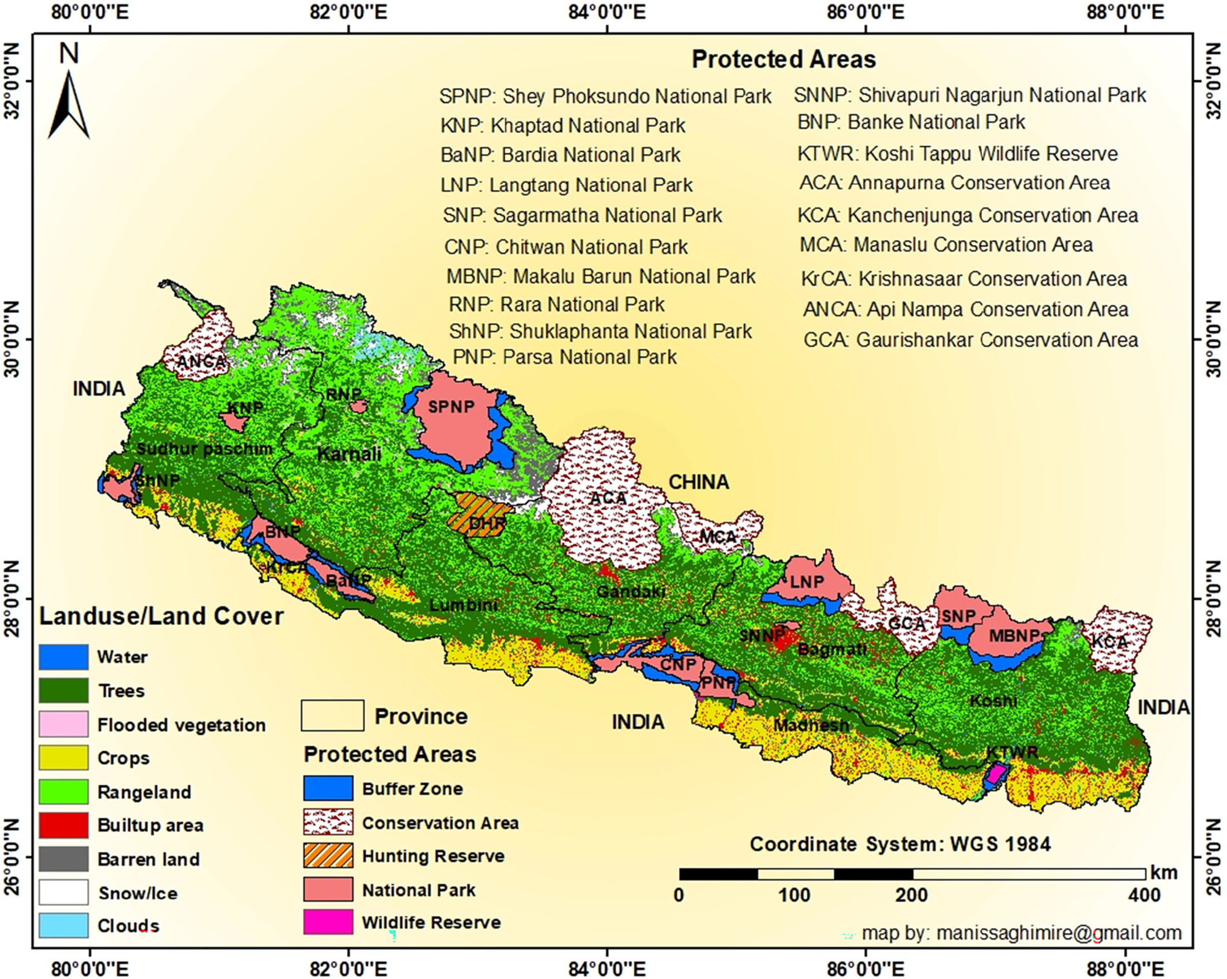

Slide 9
Types of Fruit Crops in Nepal
Tropical (75-750m): Mango, banana, pineapple, jackfruit, papaya.
Subtropical (750-1500m): Citrus (mandarin, sweet orange, lime), guava, pomegranate.
Temperate (>2000m): Apple, pear, walnut, apricot, peach, plum.
Plantation Crops: Large cardamom, coffee, tea.
*Figure*: Table categorizing fruit crops by climatic zones

Slide 10
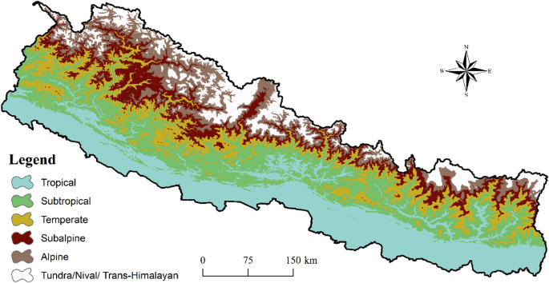

Slide 11
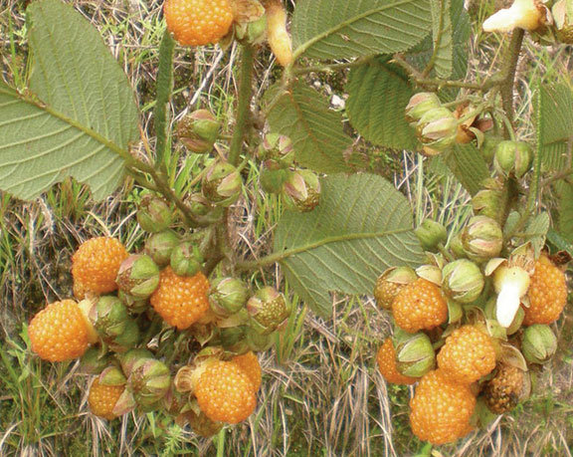
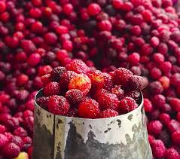
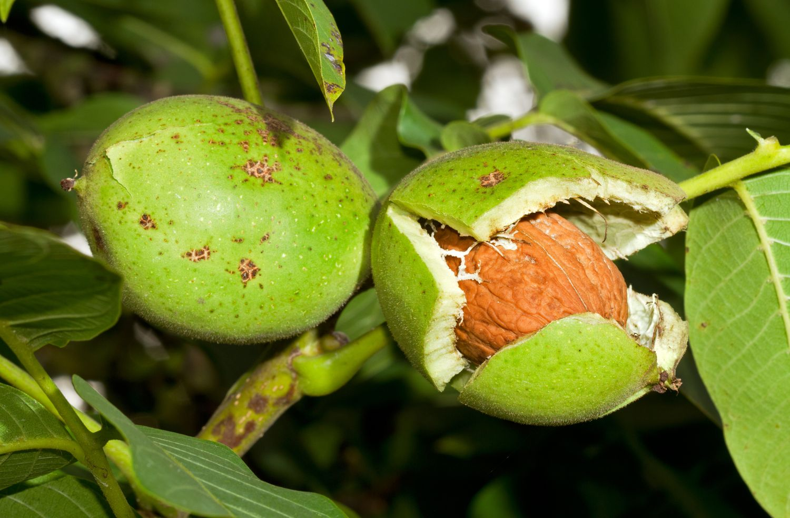
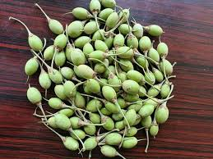
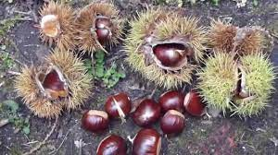


Slide 12
Indigenous Fruit Crops in Nepal
Ainselu (Rubus ellipticus): Golden Himalayan raspberry, grows wild in hills.
Kafal (Myrica esculenta): Nutritious wild fruit in mid-hills.
Jamun (Syzygium cumini): Found in jungles, rich in antioxidants.
Chiuri (Diploknema butyracea): Valued by Chepang community, used for butter and oil.
Chutro (Berberis asiatica): Shrub with wine-making potential.
Others: Bael, chestnut, citron, figs, olive, prunes.

Slide 13
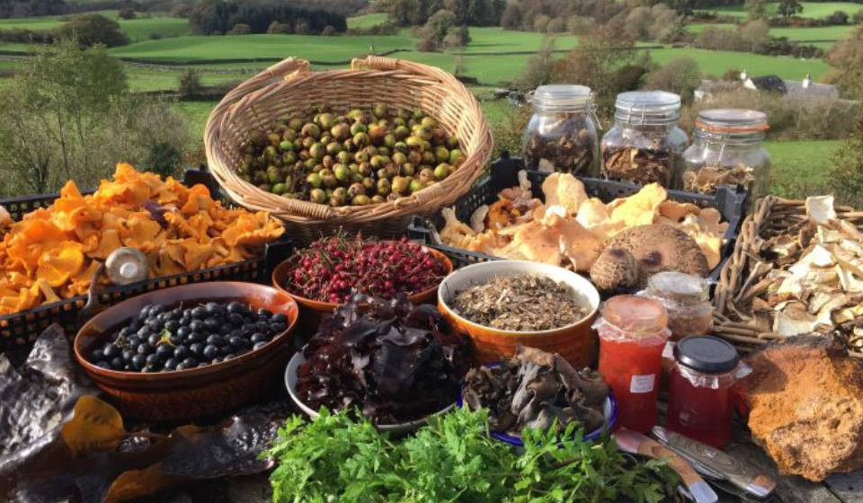
Exploring Indigenous Fruit Crops
Conservation Needs: Many indigenous fruits are underutilized and lack research.
Cultural Significance: Chiuri is a dowry tradition among Chepangs.
Nutritional Benefits: Provide food security and nutrition to rural communities.
Challenges: Modernization and habitat destruction threaten indigenous varieties.
Opportunities: Promote commercialization to reduce import dependency (e.g., walnuts, figs).

Slide 14
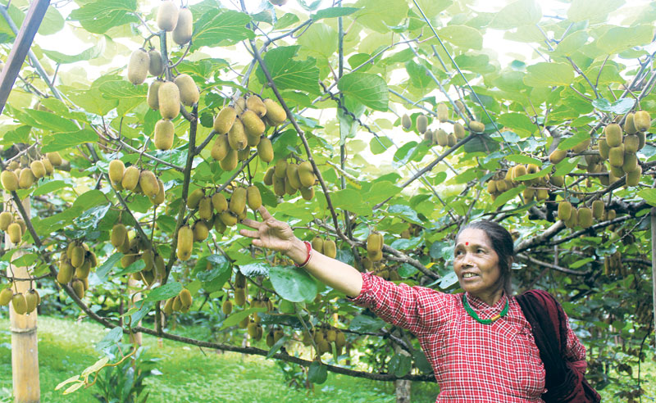
Conclusion
Horticulture is vital for Nepal’s nutrition, economy, and environment.
Diverse branches and agro-climatic zones offer immense scope.
Indigenous fruits like ainselu and chiuri hold untapped potential for food security and cultural preservation.
Future Focus: Research, conservation, and commercialization of indigenous crops.

Slide 15
References
Helpforag.app, 2018.
Slideshare.net, 2024.
Slideshare.net, 2024.
Biologynotesonline.com, 2024.
Researchgate.net, 2019.
Slideshare.net, 2024.
Slideshare.net, 2019.
*Figure*: Nepalese flag with a horticultural garden background

